Slide 1
Signal Processing
Trainning

Slide 2




< ?

Slide 3
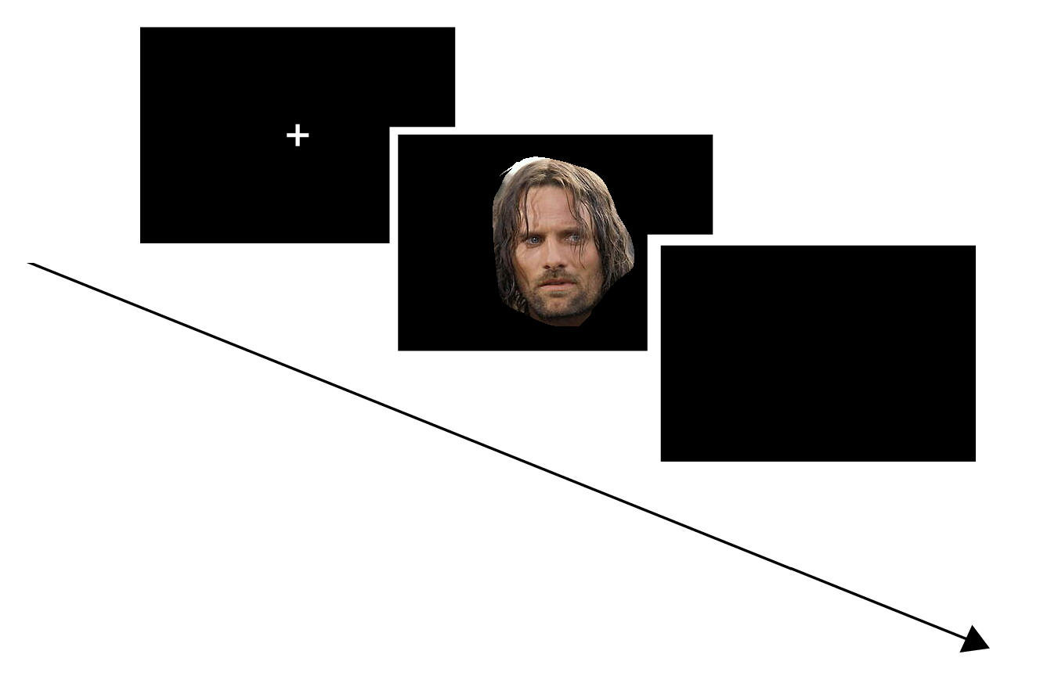
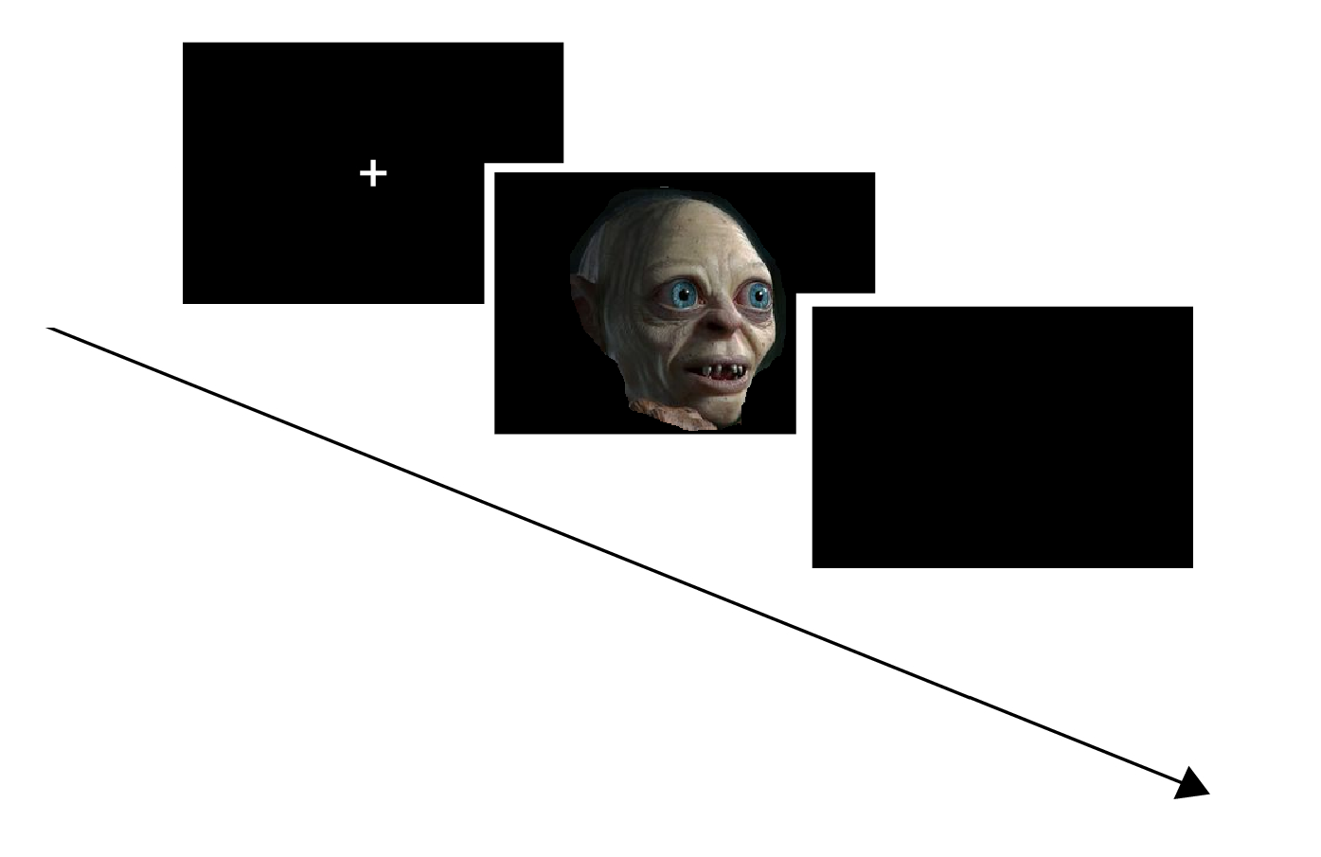
Protocol
ARAGORN
200 trials * 3s = 10min
GOLUM
200 trials * 3s = 10min
20min total randomisé
500ms
500ms
1500-
2000ms
2500-3000ms

Slide 4
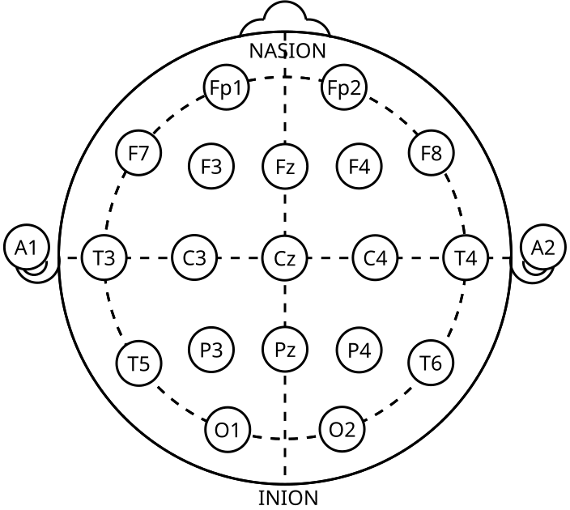
Math & Meth
FCz
21 channels, 250Hz, ref FCz

Slide 5
Ref
https://www.sciencedirect.com/science/article/pii/S0149763424004123?via%3Dihub
https://onlinelibrary.wiley.com/doi/abs/10.1002/hbm.460020306
https://pmc.ncbi.nlm.nih.gov/articles/PMC4947051/

